Slide 1
LINUX CHAR DEVICE DRIVERS
Chandru D S

Slide 2
Table of Contents
Introduction
Kernel Architecture
Classification of driver
Modules
Kernel Module vs Application
Device driver basics
Major and minor number
Allocating and freeing device number
Important data structure
Device registration
Scull and Demo
Conculsion

Slide 3
Introduction
Drivers are interface between hardware and
internal programming.
It is mechanism not policy.

Slide 4
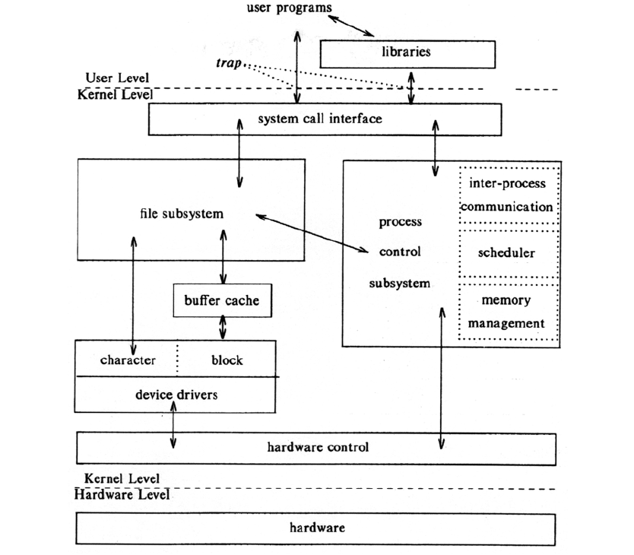
Kernel Architecture

Slide 5
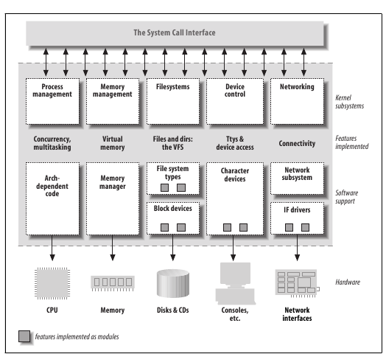
Split view of Kernel

Slide 6
Classification of driver
Character device driver:
  Similar to a file as accessed by one bytes at a time.
  Major operations are open ,read and write and close.
  Eg : /dev/console and (serial port) /dev/ttySO.
Block device driver:
  It is also in /dev directory
  Access is done using buffer and not directly
  Operation is done to buffer and later the update is made to the disk

Slide 7
Continued...
Network Device driver:
  It is used to connect to other host
  Transmission are done using some protocols.

Slide 8
Modules
Linux kernel has the ability to extend at run time.
We can add and remove modules at runtime .
Module is a piece of object code added at runtime
To do this we have insmod and rmmod

Slide 9
Kernel Module vs Application
Kernel Module
  Run in kernel space .
  No use of library function.
  Modules should be removed carefully in exit.
  For display of message – printk.
Application
  Run in user space.
  Uses library function.
  Not necessary to release the resource
  For display of message - printf.

Slide 10
Compiling And Loading Modules
Obj-m += modulename.o
Module is modulename.ko
Insmod module name
Rmmod module name
If versions are changed we need to recompile the code.
Use dmesg or cat /var/log/syslog

Slide 11
Device Driver Basics
module_init
module_exit
insmod
rmmod
lsmod

Slide 12
MAJOR NUMBER AND MINOR NUMBER
In linux every thing is files
Character device are special files
Found in /dev
ls -l observe the c in the file type section
crw-rw-rw- 1 root root 1, 3 Apr 11 2002 null
crw------- 1 root root 10, 1 Apr 11 2002 psaux
crw------- 1 root root 4, 1 Oct 28 03:04 tty1
crw-rw-rw- 1 root tty 4, 64 Apr 11 2002 ttys0
crw-rw---- 1 root uucp 4, 65 Apr 11 2002 ttyS1
crw--w---- 1 vcsa tty 7, 1 Apr 11 2002 vcs1
crw--w---- 1 vcsa tty 7, 129 Apr 11 2002 vcsa1
crw-rw-rw- 1 root root 1, 5 Apr 11 2002 zero

Slide 13
Continued...
Major Number
Identifies the driver associated with the device
Minor Number
It is used by kernel to determine the type of device referred to
Some Key Points:
  dev_t type (linux/types.h) hold the device number
  For Version 2.6.0
    Major number = 12 bits
    Minor Number = 20 bits
MKDEV(int major, int minor) : make your own device type

Slide 14
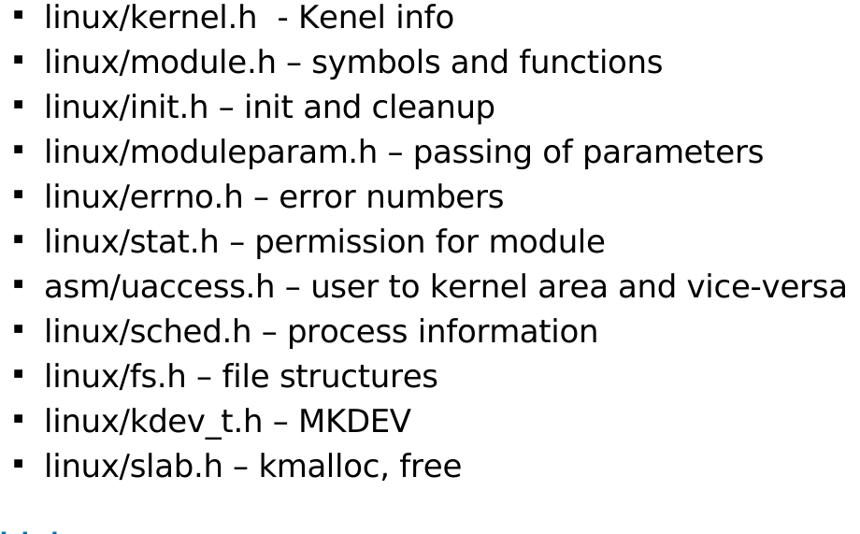
Basic Header file

Slide 15
Allocating & Freeing the Device Numbers
We have three function defined in <linux/fs.h>
Static allocation :
int register_chrdev_region(dev_t first,unsigned int count,char *nam);
Dynamic allocation:
int alloc_chrdev_region(dev_t *dev,unsigned int firstminor,unsigned int count,char *nam);
Free the deice number:
void unregister_chrdev_region(dev_t first, unsigned int count);

Slide 16
Important data structures:
Following are the three important data structure
  Struct file
  Struct file_operation
  Struct inode
These structures are decalared in <linux/fs.h>

Slide 17
Struct file
Important field of struct file
Struct file {
mode_t f_mode;
loff_t f_pos;
unsigned int f_flags;
struct file_operation *f_op;
void *private_data;
};

Slide 18
Struct file_operation
Struct file operations{
struct module *owner;
ssize_t (*read)(struct file *, char __user *, size_t, loff_t*);
ssize_t (*write)(struct file *, const char __user *,
size_t, loff_t *);
int (*open) (struct inode *, struct file *);
int (*release) (struct inode *, struct file *);
};

Slide 19
Continued...
struct file_operations scull_fops {
.owner = THIS_MODULE,
.read = scull_read,//return -EINVAL ON FAILURE
.write = scull_write,//return -EINVAL ON FAILURE
.open = scull_open,
.release = scull_release,
};

Slide 20
Struct inode
Two important field of struct inode are
struct inode {
dev_t i_rdev;
struct cdev *i_cdev;
};

Slide 21
Char device registration
We have to include <linux/cdev.h> header file
To initialize our char device:
void cdev_init(struct cdev *cdev,strct file_operation *fops)
To add our char device :
int cdev_add(struct cdev *cdev,dev_t num,
unsigned int count);
To remove our char device:
void cdev_del(struct cdev *dev);

Slide 22
SCULL
SCULL (simple character utility for loading localities)
SCULL just performs operation on a memory area,
allocated from kernel.
SCULL is easy to compile and run
SCULL is portable across linux.
No extra hardware is required to write SCULL.

Slide 23
Demo :
Hello World module
Loading and unloading our kernel module
Scull driver
Scull Apps

Slide 24
Conclusion:
Give life to devices
It forms a bridge between your application and
your hardware.
Based on device driver ,performance of system varies

Slide 25
References :
http://www.learninglinuxkernel.com
http://www.freesoftwaremagazine.com/articles/drivers_linux
Linux device driver -by Corbet ,Rubini and Greg

Slide 26
Thank You

